Slide 1
Yahoo acquisition of Tumblr Company projections and valuation
SingRs
Shahan ASHRAF
Fabio BRITO DA FONSECA
Alana HARRIS
Dimitar MILENKOV
Misha OBOLONSKYI
January 2019

Slide 2
Overview
May 2013:
Yahoo is considering making an offer of USD $1.1 billion to acquire Tumblr, a microblogging site platform with rapid growth and great potential.
Tumblr, founded in 2007, has enjoyed rapid, steady growth over the previous 5 years, however monthly active user (MAU) numbers have declined over the previous 6 months (November 2012 was the first month that saw the downturn)
In this deck, we present:
Average growth rates of Tumblr for the previous 12 and 37 months
The projected MAU growth rates of Tumblr, according to a model we believe to be most accurate
A valuation of Tumblr using our model,
Our recommendations for whether the acquisition should go ahead

Slide 3
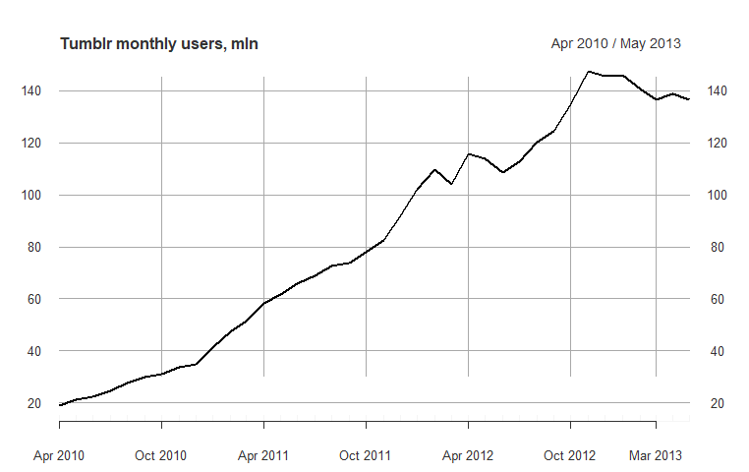
Tumblr MAUs from April 2010
Tumblr has enjoyed a rapid growth rate over the previous 3 years, with visitor numbers increasing from 20m to 140m MAUs, however user numbers have declined in the most recent 6 months.
**MAUs are defined as the estimated number of people worldwide accessing a property in a particular month
Data source: Quantcast, “Tumblr Blog Network,” https://www.quantcast.com/tumblr.com (accessed Jul. 3, 2014).

Slide 4
Tumblr Average Growth Rates
Time period | Average MAU growth rate | Valuation
Previous 37 months (Apr 2010 – May 2013) | 5.32% | $54,800,000,000
Previous 12 months (Jun 2012 – May 2013) | 1.52% | $1,230,000,000
Tumblr had a very large initial growth rate, as absolute numbers were much lower. As seen in the chart on the previous slide, they initially went from just under 20m MAUs in Apr 2010 to around 60m in Apr 2011, growth of 200% in 12 months. Spread over the 37 months we have data for, the growth rate was 5.32%. This growth rate would lead to a valuation of more than $54 billion, which is very unrealistic.
However, as the user base grew, these levels of growth could not be maintained. Therefore, we see the growth rate in the previous 12 months is slowing significantly from 3 years ago, to just over 1.5% MAU growth per month. This growth rate would result in a valuation of approximately $1.23 billion.

Slide 5
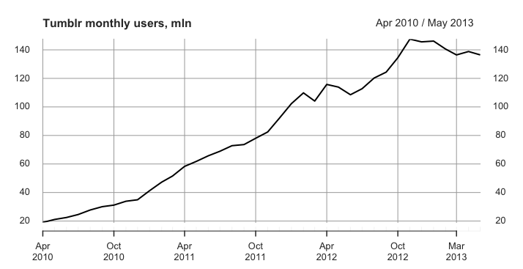
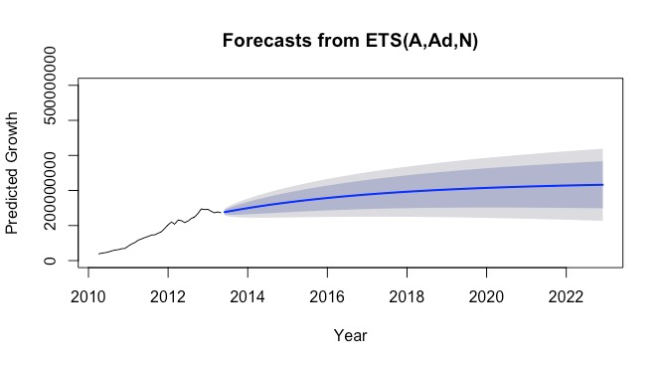
Tumblr MAUs forecast
Tumblr’s MAUs time series data exhibits:
a clear trend
no discernable seasonality
no multi-seasonal patterns
no autocorrelation
Consequently, non-seasonal ETS is preferred for forecasting to ARIMA and TBATS methods.
The trend and error increase linearly but it is logical to expect that Tumblr’s monthly users cannot continue to grow at the same rates in the future. As a result, ETS(A,Ad,N) is the most appropriate model to forecast Tumblr’s MAUs.

Slide 6
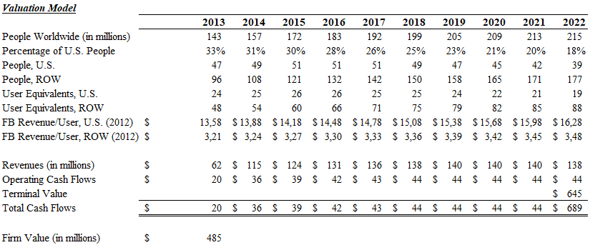
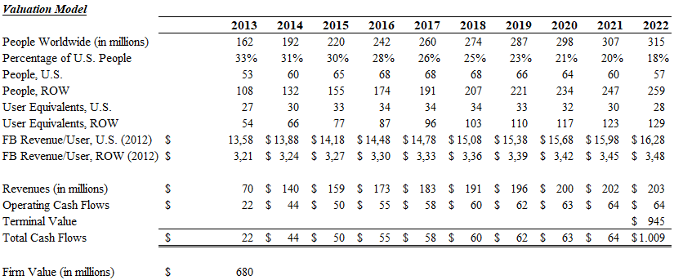
Tumblr Valuation
Using ETS(A,Ad,N) to forecast the mean values for Tumblr’s MAUs, the company valuation stands at $485,000,000
Even the best (95th percentile) forecasted expected values for Tumblr’s MAUs, give only a valuation of $680,000,000

Slide 7
Conclusion/Recommendation
We conclude that, based on this forecast, Tumblr is not worth a purchase price of USD$1.1 billion.
User growth will likely flatten out, predicted by our model to occur around 200 million MAUs, in the year 2020
Tumblr will be worth $485m, with a 95% confidence interval that the price will be no more than $680m
However, this model is an indication, and does not take into account:
Possibly synergies between Yahoo and Tumblr, with respect to better use of resources, other efficiency savings, or new product possibilities
Tumblr is still a growing company; if Yahoo feel they have a good enough plan to make use of the resources, or they wish to remove Tumblr from the market, USD$1.1 billion may be a fair purchase price. Other factors will need to be taken into account.

